Slide 1
CSC 101 – Introduction to Computing
Lecture 5-6

Slide 2
Number Conversion
Decimal to Binary and Binary to Decimal
Decimal to Octal and Octal to Decimal
Decimal to Hexadecimal and Hexadecimal to Decimal
Binary to Hexadecimal
Octal to Hexadecimal
Hexadecimal to Binary and Octal

Slide 3
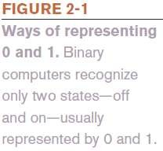
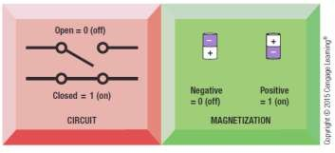
Data and Program Representation
Digital Data Representation
Coding Systems
Used to represent data and programs in a manner
understood by the computer
Digital Computers
Can only understand two states, off and on
(0 and 1)
Digital Data Representation
The process of representing data in digital form so it can be understood by a computer

Slide 4
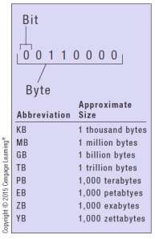

Digital Data Representation
Bit
The smallest unit of data that a binary computer can recognize (a single 1 or 0)
Byte = 8 bits
Byte terminology used to express the size of documents and other files, programs, etc.
Prefixes are often used to express larger quantities of bytes: kilobyte (KB), megabyte (MB), gigabyte (GB), terabyte (TB), petabyte (PB), exabyte (EB), zettabyte (ZB), yottabyte (YB).

Slide 5
Representing Numerical Data
Numbering System
A way of representing numbers
Decimal numbering system
Uses 10 symbols (0-9)
Binary numbering system
Uses only two symbols (1 and 0) to represent all possible numbers
In both systems, the position of the digits determines the
power to which the base number (such as 10 or 2) is raised

Slide 6
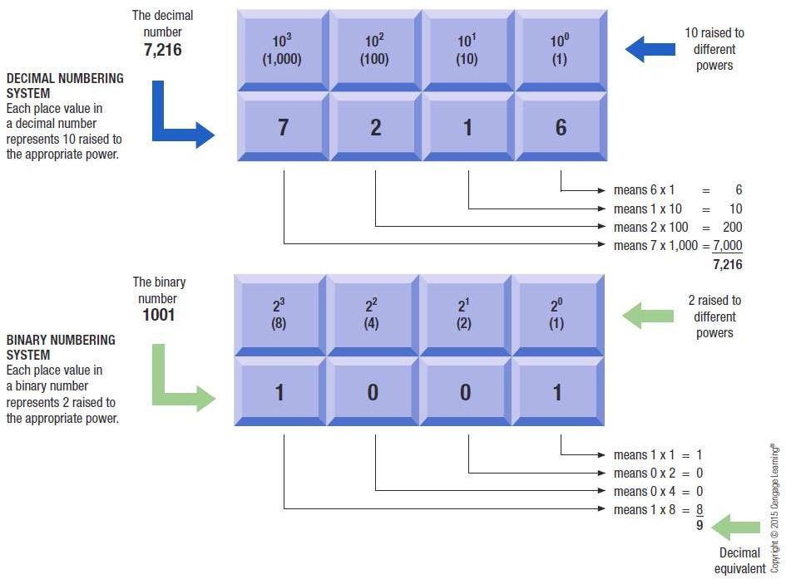
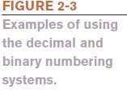
Representing Numerical Data

Slide 7
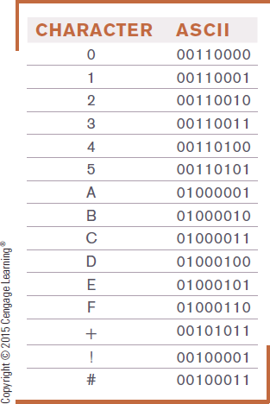

Coding Systems for Text-Based Data
ASCII (American Standard Code for Information Interchange)
Coding system traditionally used with personal computers
EBCDIC (Extended Binary-Coded Decimal Interchange Code)
Developed by IBM, primarily for
mainframes

Slide 8
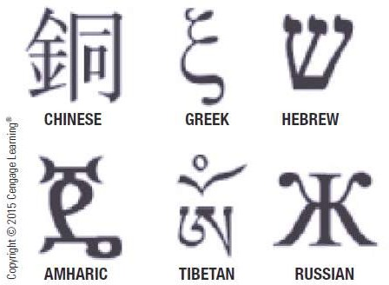
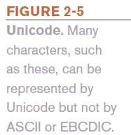
Coding Systems for Text-Based Data
Unicode
Newer code (32 bits per character is common)
Universal coding standard designed to represent text-
based data written in any ancient or modern language
Replacing ASCII as the primary text-coding system

Slide 9
Coding Systems for Other Types of Data
Graphics Data (still images such as photos or drawings)
Bitmapped images
Image made of up of a grid of small dots called pixels
Monochrome graphic can only be one of two colors
Requires just one bit for color storage
Images with more than two colors
Can use 4, 8, or 24 bits to store the color data for each pixel
More bits = more colors

Slide 10
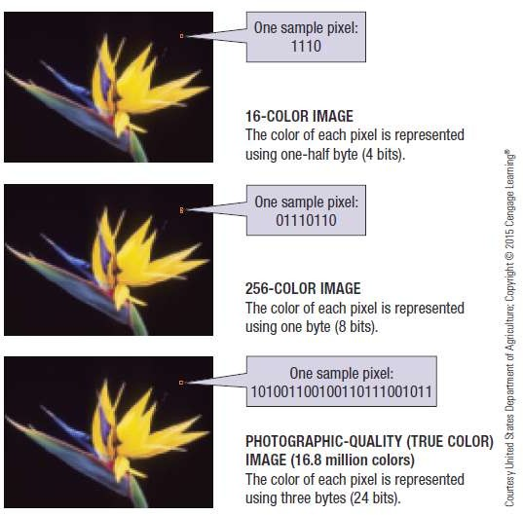
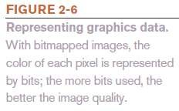
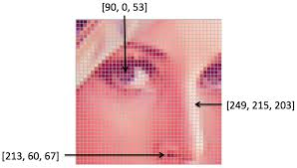
Coding Systems for Other Types of Data

Slide 11
Coding Systems for Other Types of Data
Audio Data
Must be in digital form in order to be stored on or processed by a computer
Often compressed when sent over the Internet
MP3 files are 10 times smaller than their uncompressed digital versions
Download more quickly and take up less storage space
Video Data
Displayed using a collection of frames, each frame contains a still image
Amount of data can be substantial, but can be compressed

Slide 12
Representing Software Programs
Machine language
Binary-based language for representing computer programs the computer can execute directly
Early programs were written in machine language
Today’s programs still need to be translated into machine language in order to be understood by the computer

Slide 13
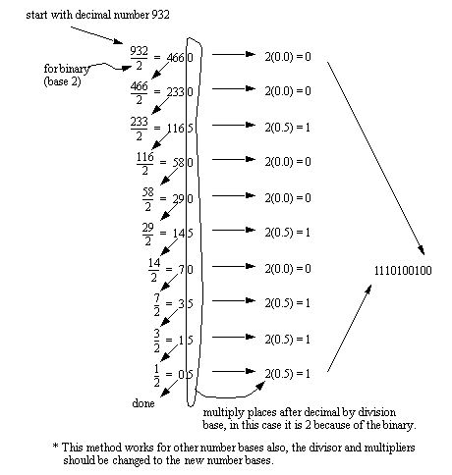
Decimal To Binary
1

Slide 14
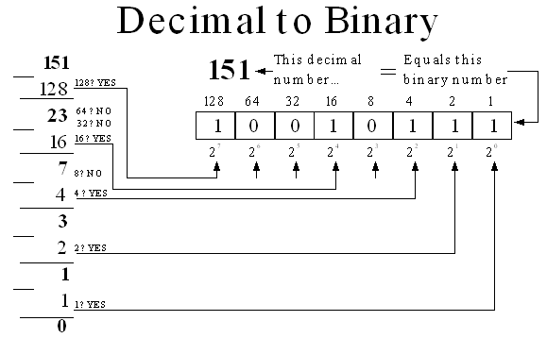
Decimal To Binary
(151)₁₀ = (10010111)₂

Slide 15
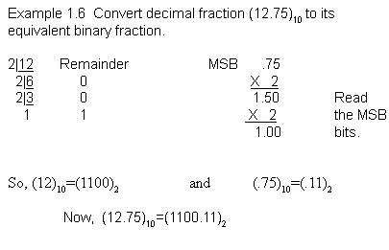
Decimal to Binary (with Fractions)
(12.75)₁₀ = (1100.11)₂
Notes:
2.47

Slide 16
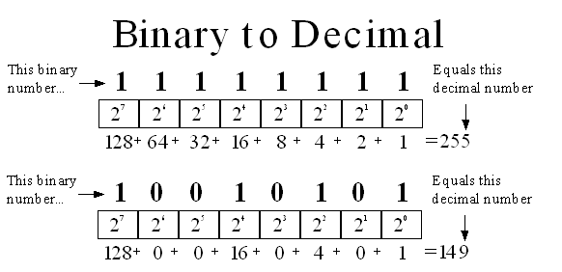
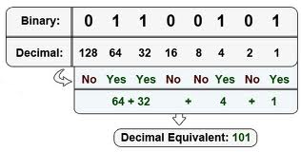
Binary to Decimal

Slide 17
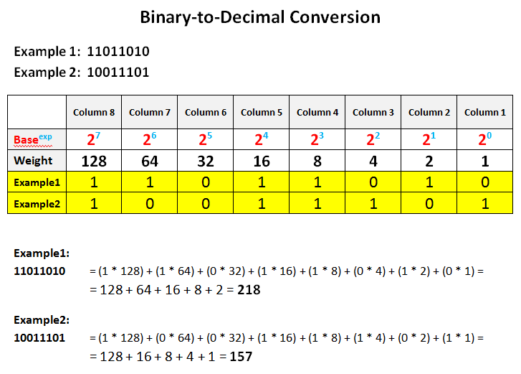
Binary to Decimal

Slide 18
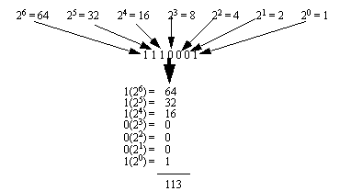
Binary to Decimal
1110001₂ = 113₁₀

Slide 19
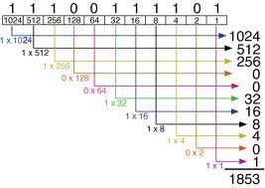
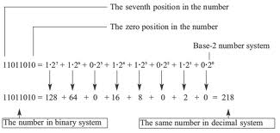
Binary to Decimal
11100111101₂ = 1853₁₀
11011010₂ = 218₁₀

Slide 20
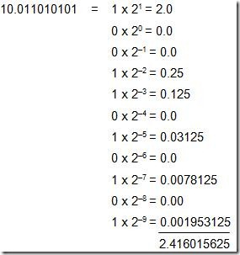
Binary to Decimal (with Fractions)
(10.011010101)₂ = (2.416015625)₁₀

Slide 21
Exercise Decimal to Binary

Slide 22
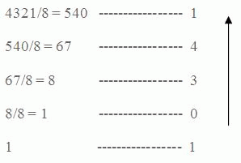
Decimal to Octal
4321₁₀ = 10341₈

Slide 23
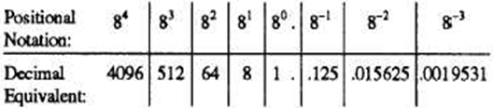
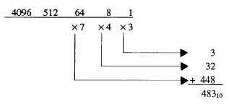
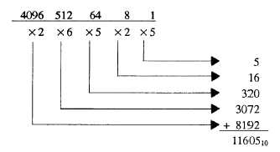
Octal to Decimal
743₈ = 483₁₀ 26525₈ = 11605₁₀

Slide 24
Exercise Decimal to Octal

Slide 25
Exercise Octal to Decimal
26601₈ =
1422₈ ₌

Slide 26
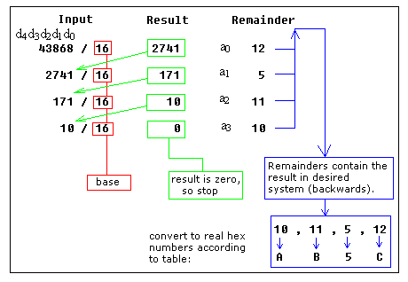
Decimal to Hexadecimal

Slide 27
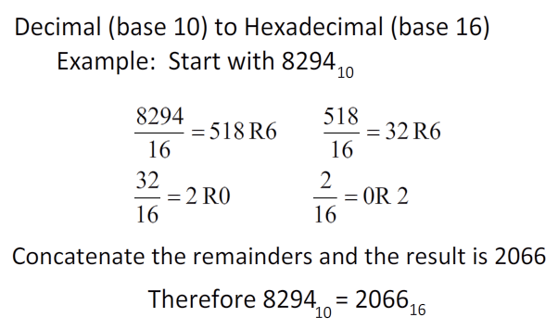
Decimal to Hexadecimal

Slide 28
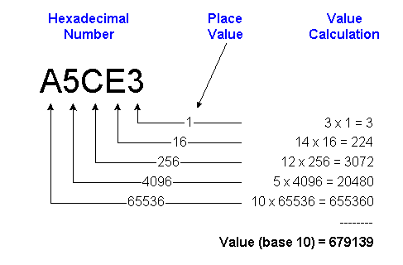
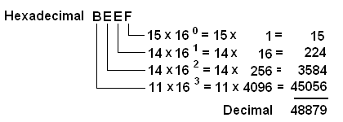
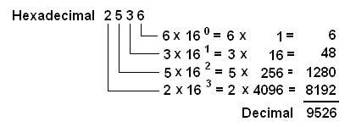
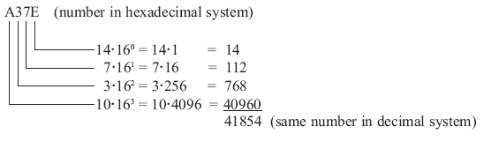
Hexadecimal to Decimal

Slide 29
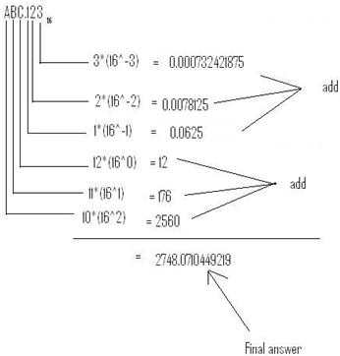
Hexadecimal to Decimal
(ABC.123)₁₆ = (2748.0710449219)₁₀

Slide 30
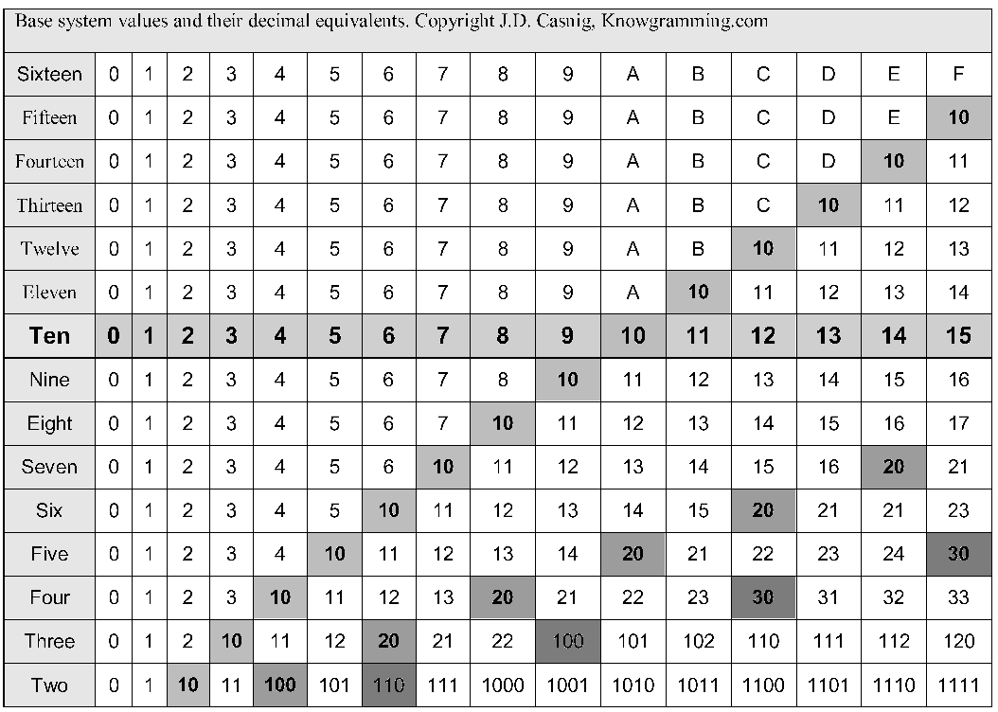
Comparison Base 2 to Base 16

Slide 31
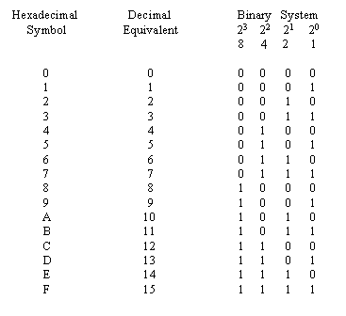
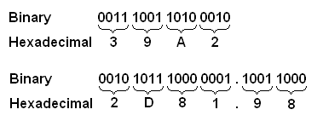
Binary to Hexadecimal

Slide 32
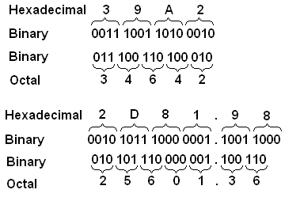
Hexadecimal to Binary and Octal

Slide 33
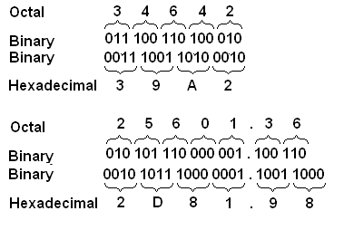
Octal to Hexadecimal

Slide 34
Exercise Binary to Hexadecimal
(10110101010101)₂
(1100010010)₂

Slide 35
Exercise Octal to Hexadecimal
(344)₈
(1422)₈

Slide 36
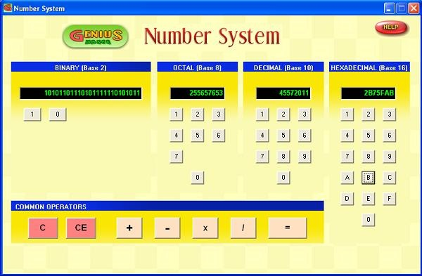
Number System Program
Genius Maker
Free software
Use the number system
http://www.goldenkstar.com/number-system-school-software-maths.htm

Slide 37
Summary
Number System
Decimal
Binary
Octal
Hexadecimal
Number conversion

Slide 38
Recommended Websites
http://www.cdrummond.qc.ca/cegep/informat/Professeurs/Alain/files/ascii.htm
http://www.lookuptables.com/ebcdic_scancodes.php
http://math.comsci.us/radix/hexadecimal.html

Slide 39
Number System - Exercise
Decimal | Binary | Octal | Hexadecimal
(786)₁₀ | (1100010010)₂ | (1422)₈ | (312)₁₆
(555)₁₀ | (1000101011)₂ | (1053)₈ | (22B)₁₆
(228)₁₀ | (11100100)₂ | (786)₈ | (786)₁₆
(179)₁₀ | (10110011)₂ | (786)₈ | (786)₁₆
(483)₁₀ | (111100011)₂ | (743)₈ | (1E3)₁₆
(4012)₁₀ | (111110101100)₂ | (7643)₈ | (FAC)₁₆
(4321)₁₀ | (1000011100001)₂ | (10341)₈ | (10E1)₁₆
(1853)₁₀ | (11100111101)₂ | (3475)₈ | (73D)₁₆
(9526)₁₀ | (1001010011011)₂ | (22466)₈ | (2536)₁₆
(11605)₁₀ | (10110101010101)₂ | (26525)₈ | (2D55)₁₆
(48879)₁₀ | (111111011101111)₂ | (137357)₈ | (BEEF)₁₆

